Slide 1
Tier Determination
Sponsors of Day Care Homes

Slide 2
Overview
Determination Dates
Documentation

Slide 3
Tier Determination Dates
When do you need to re-determine tier 1 classifications?

Slide 4
Tier Determination Dates
Policy: Sponsor must qualify Tier 1 day care homes using school data, census data, or provider income data. When determining if a home meets Tier 1 criteria, the sponsor must consult school data prior to using census data or provider income data.
School Data Tier 1 Home
Tier 1 home eligibility based on school data must be re-determined at least every five years from the previous date of eligibility determination.

Slide 5
School Data Tier 1 Re-Determination
Example:
If an initial determination is made June 16, 2017, and is effective June 1, 2017, when must the tier re-determination be made by a sponsor of day care homes?
Answer:
Re-determination must be completed by the end of June 2022, and will be effective June 1, 2022.

Slide 6
Census Data Tier 1 Re-Determination
True or False: A census data tier 1 home has to be re-determined every 10 years?
False
Tier 1 home eligibility that is based on census data must be re-determined each time a new census is released by the federal government and approved for use by the USDA.
Also must be re-determined every five years
DOH CCFP Memo March 27, 2012
“…eligibility must be reassessed every five years for provider qualified by census data…”

Slide 7
Provider Income Data Tier 1 Re-Determination
At a minimum, Tier 1 home eligibility that is based on provider income data must be re-determined annually from the date the provider signed and dated the form or from the date the sponsor approved the form if it was not dated by the provider

Slide 8
Tier 2 Re-Determination
Tier 2 providers must be informed they can request a reclassification review
Re-determination should be made annually

Slide 9
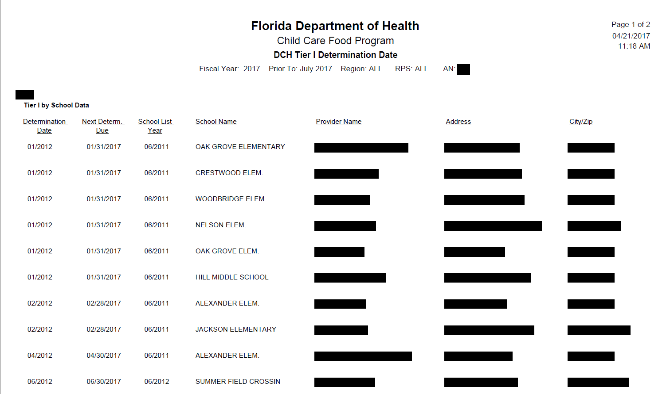
DCH Tier 1 Determination Date
Utilize the DCH Tier 1 Determination Date Report
You can look at previous and upcoming months
Lists determination date, next determination date due, provider name, address, etc.

Slide 10
Documentation
What can a sponsor use for documenting Tier 1 Home based on school data?
Is there a new census map that a sponsor can use for determining Tier 1 Home?

Slide 11
School Data Documentation
The sponsor must determine and document school zone information for each day care home qualified as Tier 1.
The sponsor must verify the school zone by one of the following methods:

Slide 12
School Data Documentation
Local School Board Website:
Explore the site to find school zone listings.
Type in the address of the day care home.
Print the page that lists the school zone for the DCH.
Computer generated printing date is necessary.

Slide 13
School Data Documentation
Current county elementary school-zone map from the school board
Copy the section of the map that includes the school zone of the DCH.
Mark the location of the DCH.
Highlight the school zone boundaries.

Slide 14
School Data Documentation
School Board Contact
Obtain a school board official’s attestation of the day care home’s school zone written on school board letterhead, or
Place a memorandum in the day care home’s file, which details the school zone information provided by the school board official(s), the name(s) of the official(s) consulted, and the date the information was obtained.
Maintain a copy of the current county school zone map from the school board on file

Slide 15
Documentation that is not allowed
Google Maps
Non-school Board Maps

Slide 16
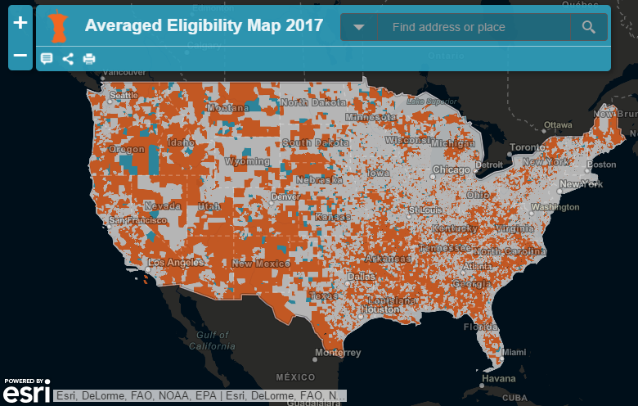
A new census map that a sponsor can use for determining Tier 1 Home

Slide 17
USDA’s Averaging Policy
Area Eligibility using census data= 50% or more of children in a Census Block Group or Tract are eligible for free and reduced price meals.
Averaging policy – a census block group with at least 40% FRP eligible children may be averaged with one or two adjacent block groups to meet the 50% area eligible threshold
18 and under data or 12 and under data may be used

Slide 18
Maps that can be used
http://www.fairdata2000.com/CACFP/index.html
https://bestpractices.nokidhungry.org/events/2016/august/24/new-tool-averaged-eligibility-map

Slide 19
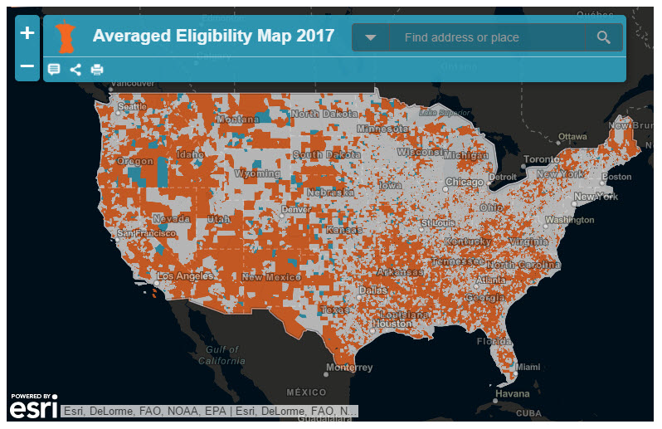
Notes:
The main purpose of this map is to quickly show you if a day care home is located in a block group that meets the 50 percent free and reduced price area eligibility criterion when averaged with adjacent block groups

Slide 20
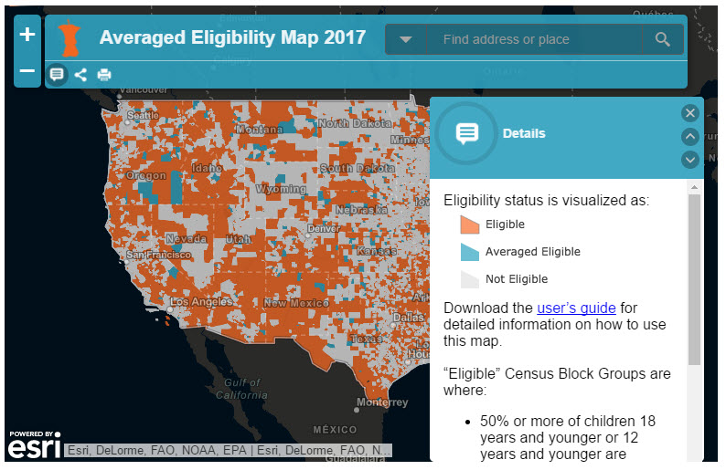
Notes:
This is the detail box of the map and it shows you some key information about the map. The first is the legend, which is in the red box. All block groups are color coded by eligibility status in the map. The block groups in orange are those that meet the 50% area eligibility threshold on their own and block groups in gray reflect locations that are not area eligible. These two categories of block groups are consistent with the area eligibility information that is presented in the USDA capacity builder and FRAC mapper, which all of you should already be familiar with. The blue color means that the block group only meets the 50% area eligibility threshold when it is averaged with at least one and up to two adjacent block groups. We call these block groups potentially eligible in the legend of this map, only because there is the added the sponsor and then state agency needs to verify that they are actually eligible through the use of averaging. But the block groups will only show up as blue on the map if they do in fact meet the 50% threshold as a result of the averaging.
I also want to point out the green box, which contains the link to download the user’s guide, which will help you to interpret the map and how to use the data provided in the map to submit a request to DOH to get your site formally designated as area eligible.
To close the Detail box, click on the “X,” and if you need to go back to the detail box, just click right here. The Plus and Minus in the Yellow box is used to zoom in and zoom out of the map.
And then the first step to using this map is to input the address of the day care home into the search bar at the top of this picture.

Slide 21
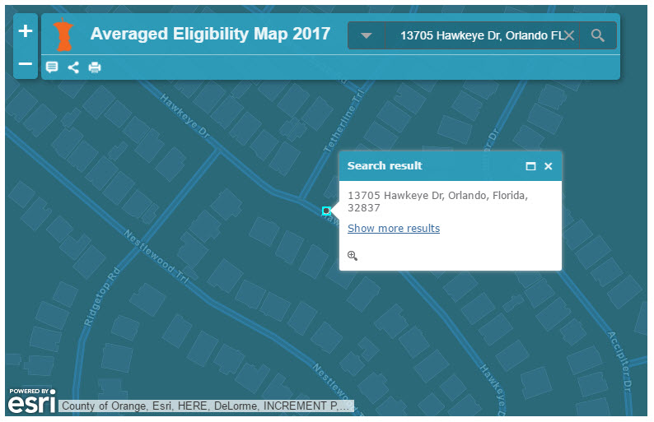
Notes:
When you input the address into the search bar, you’ll see something like this. You’ll be shown the location at street level. So you can see our example 13705 Hawkeye Dr, Orlando, FL 32837 is located in a blue census block group. This means that this block group is considered potentially eligible and the day care home is area eligible as a result of averaging. You are likely to want to zoom out to get a better sense of where you are in this map, which you can do by clicking this zoom out button.

Slide 22
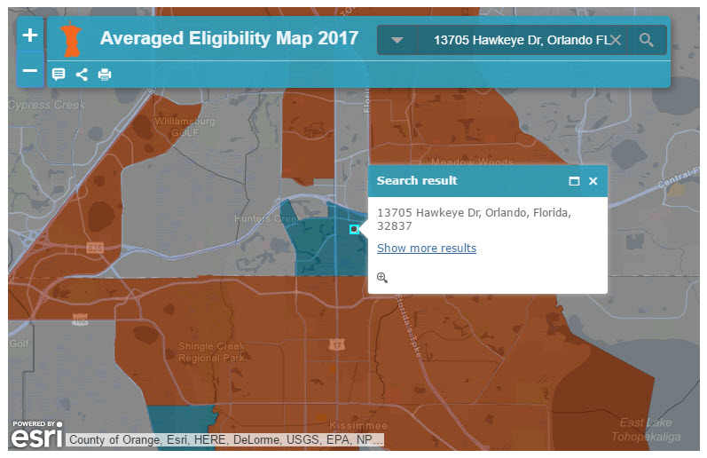
Notes:
So when you use that button to zoom out a few times, your map should look like this. So in a nutshell you’ve determined that the day care home is potentially eligible. Now what you will need to do next is determine how to access the information that you will need to verify with DOH that the home is indeed area eligible. The First thing you will want to do is close the address box, which you will do by click the “X” on the upper right hand corner. And then what you will want to do is click anywhere onto the block group that the day care home is located in to pull up the free and reduced price eligibility study information about the children living in this block group.

Slide 23
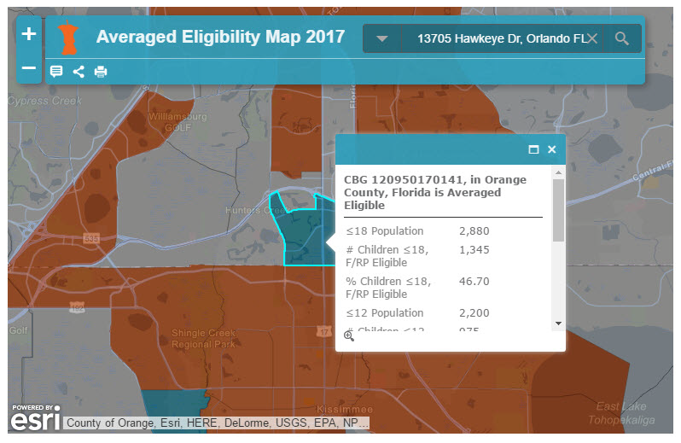
Notes:
Clicking anywhere on the block group will bring up a box that will look this this and you will want to click on the maximize button in the top right hand corner of the box so you can display all of the information without needing to scroll.

Slide 24
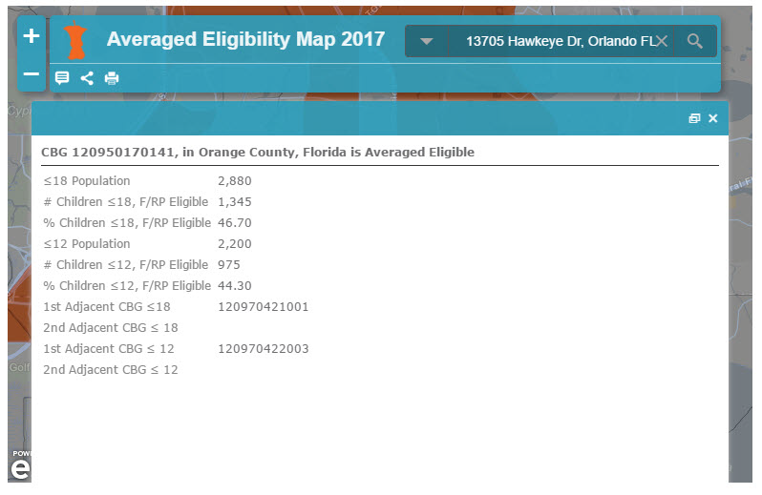
Notes:
So when you do that, it’ll open up the information box to look like this. There are a lot of numbers here and it can be confusing but I will walk you through this to hopefully make it simple and easy for you to follow when you are doing this on your own.
The first thing to note is the number at the top of this box. Every block group has a unique identifier, which you will need to provide to DOH to show where the day care home is located and which block group you are referencing. You may know that either 18 and under, or 12 and under data could be used to determine area eligibility. The map will show you the information for this block group using both types of data. This first box shows all of the 18 and under data. So what this mean is that in this block group there are 2,880 children who are ages 18 and under and of those 2,880, 1,345 are free and reduced price eligible. And this last number there shows you the percentage of children that are free and reduced price eligible, which is determined by taking 1,345 and dividing it by 2,880. When you do that you get 46.70%.
In the yellow box you see this exact same information for the 12 and under census data.
And in the green box, you have the last set of numbers, which is the hardest to make sense of. It shows you the block group(s) that the data was averaged with to make this particular block potentially eligible. In the purple box, you can see the unique identifier of the one or two eligible block group(s) that were averaged with this one to make it potentially eligible using 18 and under data. In this case, only block other block group was required to average to hit the 50% threshold, however you will see a second number listed here if two blocks were required.

Slide 25
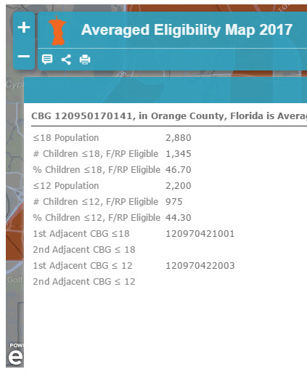
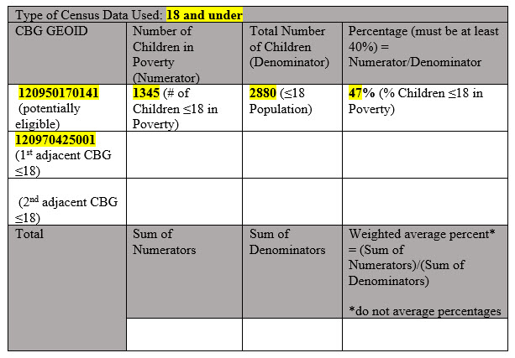
Notes:
So now I am going to show you how to take the information that was in the pop up box and put it into a format that you should submit to DOH. So you will see the box on the left has the exact same information that we just walked thought in the previous slide, and the table on the right will be provided to you to use after the webinar. This table has been provided by USDA to use.
So the first thing you will want to do is that the block group identifier at the top of the information box one the map and put it into the first column of the table. Next you will want to input the child census data into the table. Since this block group was made potentially eligible using either the 18 and under or the 12 or under data it is arbitrary which data you use. But in our example we will use the 18 and under data highlighted at the top of the table.
To complete the rest of the table, we will need to locate the area eligible block group that made our block group potentially eligible. The best way to do that is to transfer the eligible block group’s unique identifier number onto the second row of the table. And then you will want to go back to the map.

Slide 26
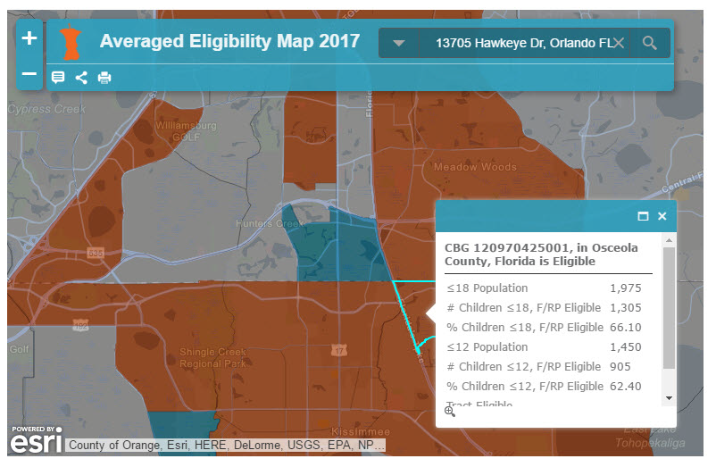
Notes:
And then you will want to go back to the map and locate the locate the area eligible block group that made our block group potentially eligible. You can see that there are multiple block groups that are adjacent to out original block group that could have been used to potentially make our original block group eligible. Unfortunately you will need to click on each potential block to identify the matching one. Clicking on each block will open a pop up similar to the one we opened when clicking on the blue block where our day care home is located. This is the particular eligible block group that made our block group potentially eligible as confirmed by this unique identifier here. You will then need to do the same thing with the information in this pop up that you did with the potentially eligible one in the previous slide.

Slide 27
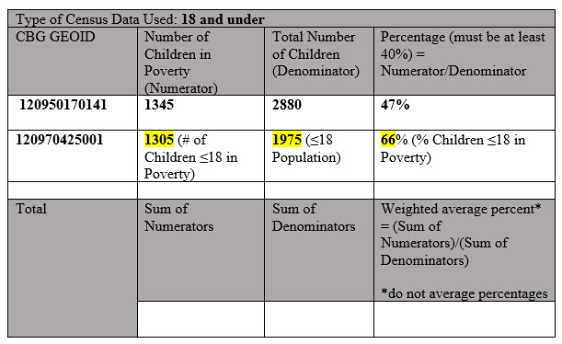
Notes:
So going back to our table, here is that same pop-up from the previous slide’s map, just put next to the table we had worked on earlier. Using the exact same steps as with the potentially eligible block group, you’ll start by putting the unique identifier into the second row first column of the table. You will then similarly want to the child poverty data into the table. You will want to make sure you are using the same data type for all of the block groups in the table.

Slide 28
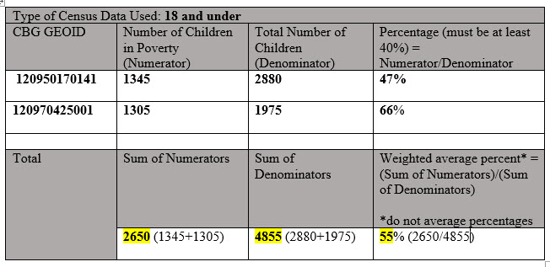
Notes:
And the last step to completing the table is to calculate the new percentage for this potentially eligible block group. It is a weighted average. You will then submit this weighted table to DOH to show us that the day care home is area eligible through the use of averaging. DOH will then submit the data to USDA and when it receives a response (positive or negative) the day care home sponsor will be notified for its records and to pass the information along to the day care home provider.

Slide 29
Thank you!

